Slide 1

Submitted From:
MD Dulal Hossain
ID : 213902116
Section : 213 D_5
Course Code : CSE 310
Title : Library Management System .
Submitted To :
MD Solaiman Mia
Assistant Professor,
Department of CSE, GUB.

Slide 2




Outline
Introduction
Implementation
Overview
Objectives
Project Details
Workflow
Source Code
Chapter 1
Chapter 2
Performance
Chapter 3
Chapter 4
Conclusion
Results Analysis
Testing

Slide 3
Introduction
Overview
Objective
This library management system prioritizes user-friendliness, facilitating efficient management of book records. It focuses on seamless addition, finding, editing, and removal of entries, maintaining organized categories, titles, and authors. Clear menus and intuitive prompts enhance ease of use.
This Shell script, conceived by Dulal, facilitates book record management through functions for adding, finding, editing, and removing entries. It boasts error handling, confirmation prompts, and a user-friendly menu interface.

Slide 4
Implementation
Project Details
Workflow
Source Code
Command-line Library Management System efficiently organizes book records with user-friendly menus. It offers functions for adding, searching, editing, and removing entries, ensuring practicality for individuals and small libraries.
The structured workflow of this Library Management System includes options for adding, finding, editing, removing, and viewing books, ensuring efficient management and user-friendly interactions.
Explain this parts for better understand.

Slide 5

Source Code
Step 5
Step 2
Step 4
Step 3
Step 1

Slide 6
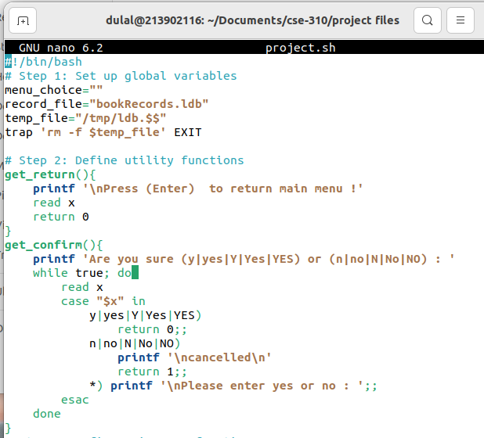
Global – Get Confirm
Step 4
Step 2
Step 5
Step 3
Step 1
Figure 2.1: Global & Get – Confirm .

Slide 7
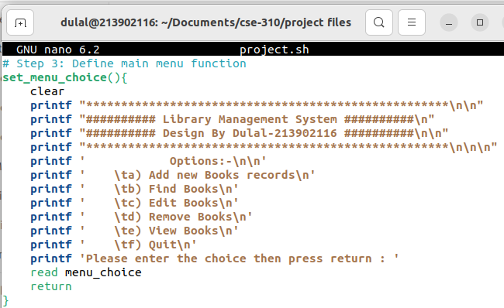
User Interface
Step 5
Step 2
Step 4
Step 3
Step 1
Figure 2.2: User Interface

Slide 8
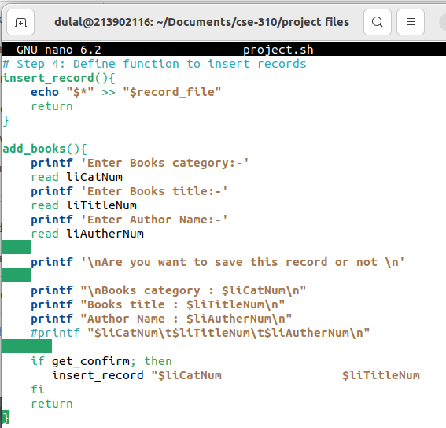
Insert Books
Step 5
Step 2
Step 4
Step 3
Step 1
Figure 2.3: Insert Books.

Slide 9
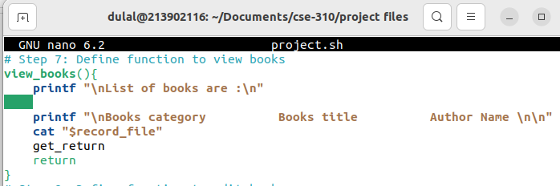
View Books
Step 5
Step 4
Step 2
Step 3
Step 1
Figure 2.4: View Book.

Slide 10
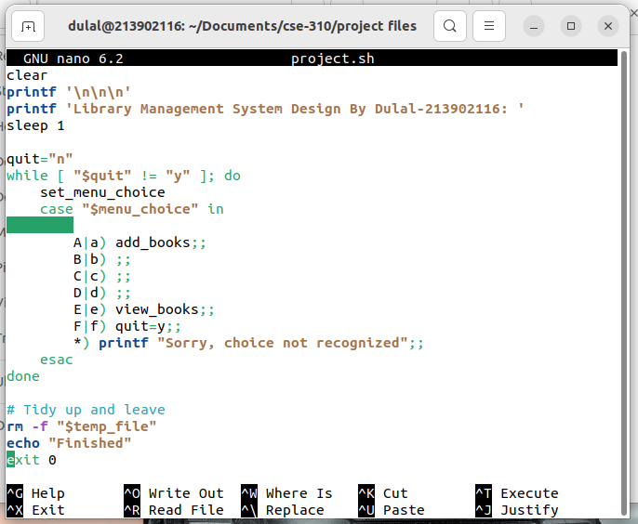
Main Menu
Step 5
Step 2
Step 4
Step 3
Step 1
Figure 2.5: Main -Menu.

Slide 11
Testing
Quit
Add Book
View Book
Menu

Slide 12
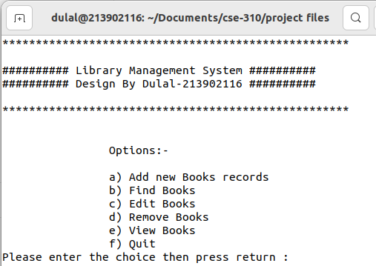
Quit
Add Book
View Book
Menu
Figure 3.1: User-Interface Part

Slide 13
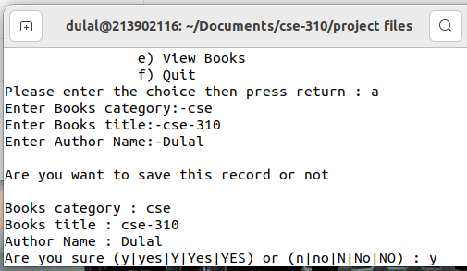
Quit
Add Book
View Book
Menu
Figure 3.2: Insert new Books

Slide 14
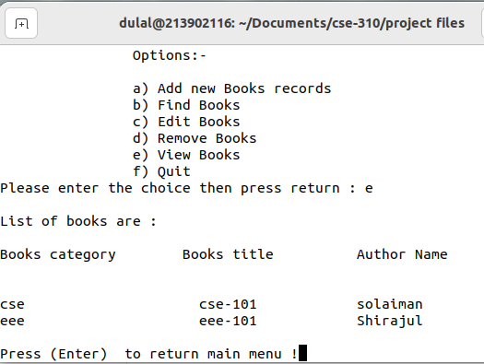
Quit
Add Book
View Book
Menu
Figure 3.3: View-Books.

Slide 15
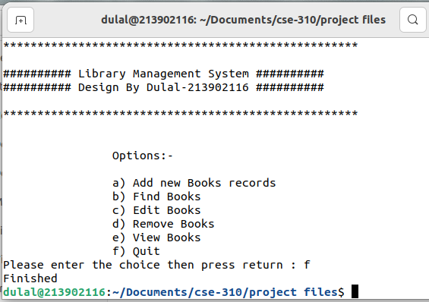
Add Book
Quit
View Book
Menu
Figure 3.7: Quit.

Slide 16
Thank You
Keep Learning, Keep Grinding

